Slide 1
IST687 M009- Data analysis for customer satisfaction index
GROUP 3-Xuehan Chen
Yanqi Yao
Advait Ramesh Iyer
Weicheng Wu

Slide 2
Objective:
To identify various trends in the customer data of flights in the US to formulate various business strategies for our client: Southeast Airlines Co.
Methodology:
Used multiple linear regression analysis and association rules to develop hypothesis
Used Support Vector Machine algorithm to validate the hypothesis

Slide 3
Content
Business questions
Descriptive statistics
Data analysis
Recommendations
Notes:
Project goals
Descriptive statistics
Linear Model
A rules

Slide 4
Variables in the model
Satisfaction (Range: 0-5)
Airline Status (Range: Blue, Gold, Silver, Platinum)
Age (Range: 15-85 years)
Gender
Price Sensitivity (Range: 0-5)
Year of First Flight (Range: 2003-2012)
Number of flights per annum (Range: 0-100)
Percentage of flights with other airlines (Range: 1-100)
Type of travel (Range: Business travel, Mileage travel, Personal travel)
Number of other loyalty cards (Range: 0-12)
Shopping amount at airport (Range: $0-$879)
Eating and drinking at airport (Range: $0-$895)
Class (Range: Economy, Economy Plus, Business)
Day of month (Range: 1-31)
Flight date (Range: 1/1/14 to 3/9/14)
Airline name: 14 different airlines
Origin city
Origin state
Destination city
Destination state
Scheduled departure hour
Departure delay in minutes (Range: 0-1592 min)
Arrival delay in minutes (Range: 0-1584 min)
Flight cancelled (Yes/No)
Flight time in minutes (Range: 8-669 min)
Flight distance (Range: 31-4983 miles)
Arrival delay greater than 5 minutes (Yes/No)

Slide 5
business questions
Notes:
Project goals
Descriptive statistics
Linear Model
A rules

Slide 6
Business Questions
What are the key reasons for customer satisfaction or dissatisfaction?
Which clusters generally come off as happy customers? Which of them come off as unhappy customers?
What should be the pricing strategy of airline packages which lead to a higher satisfaction level among the unhappy customers?
What can be any strategic improvements which can improve customer satisfaction index?

Slide 7
Descriptive statistics
Notes:
Project goals
Descriptive statistics
Linear Model
A rules

Slide 8
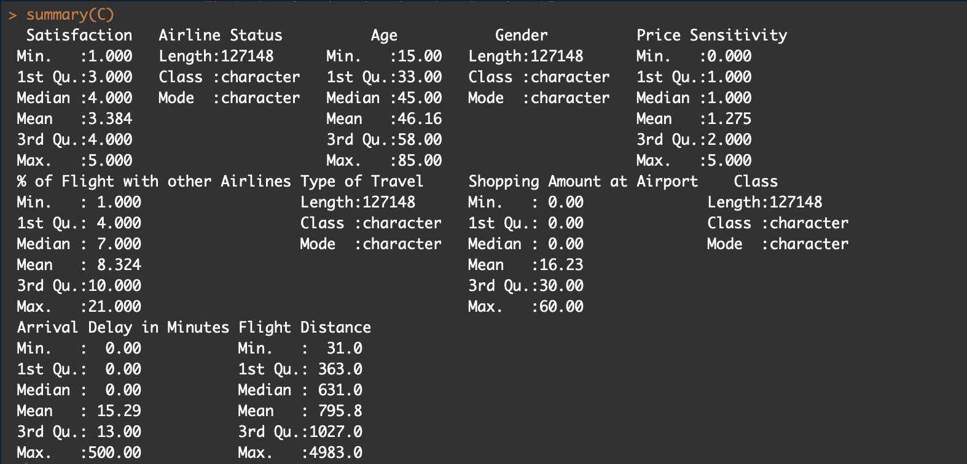

Slide 9
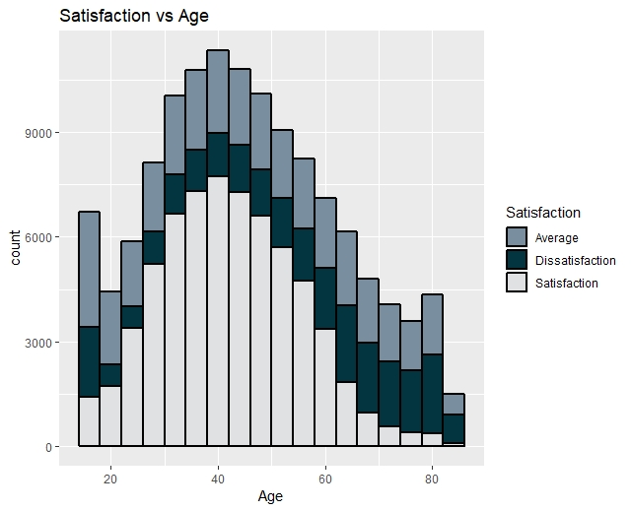
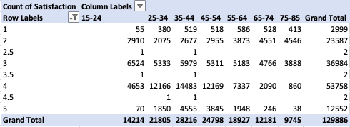
Satisfaction Vs Age
Judging by the distribution of the histogram, the dissatisfaction and average ratings increase with increase in age, and the age group 60-80 are the most dissatisfied.

Slide 10
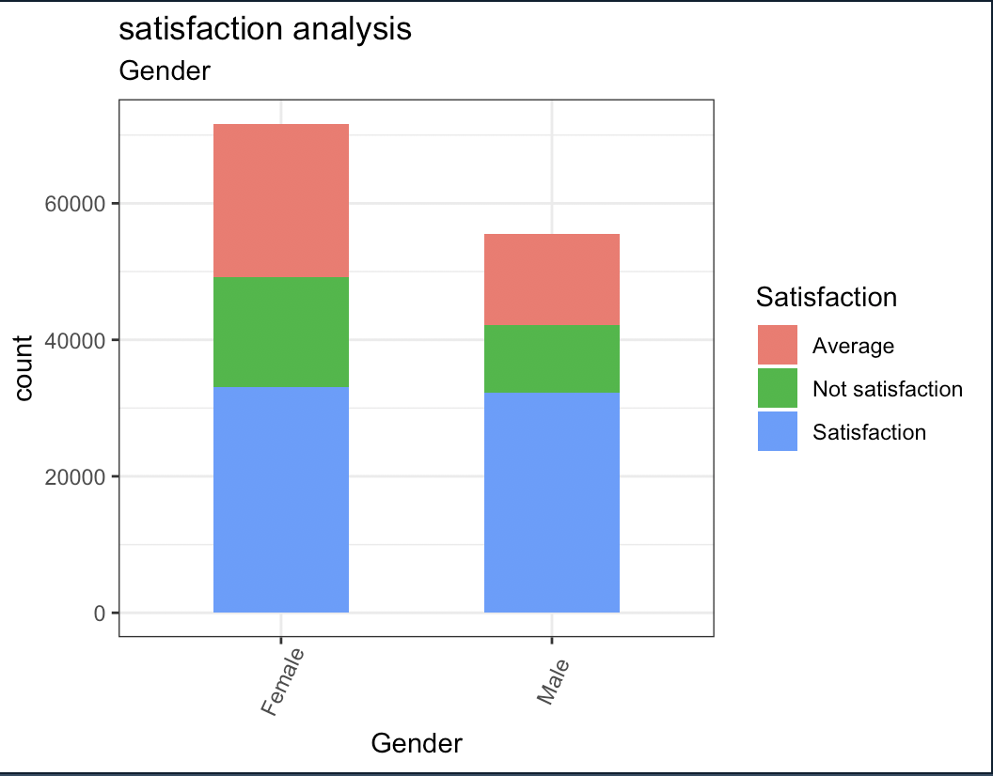
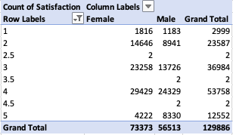
Satisfaction Vs Gender
There is a higher satisfaction level among the male customers as compared to female customers. There are more female customers who are either not satisfied or moderately satisfied.

Slide 11
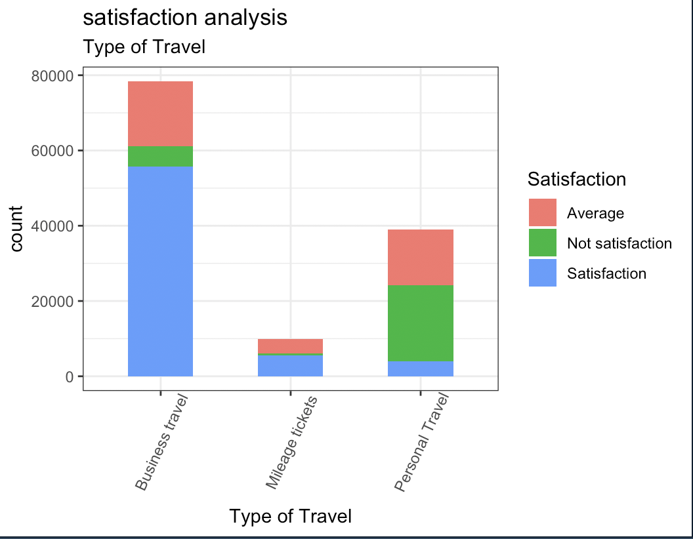
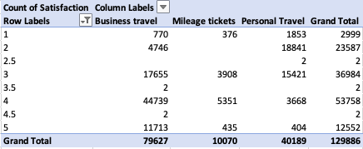
Satisfaction Vs Type of travel
Business travel is a more satisfying experience than personal travel because of reimbursements and better services
Personal travel involves customer’s own money, which is why they might be left unsatisfied

Slide 12
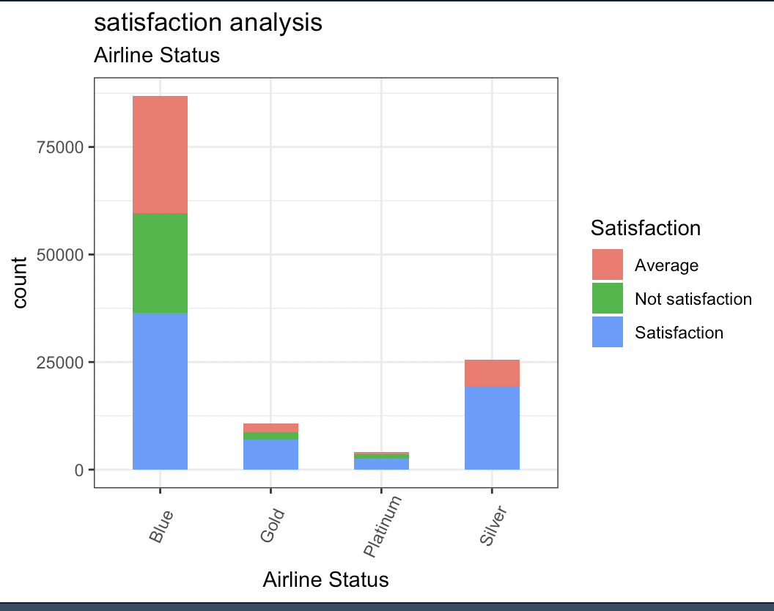
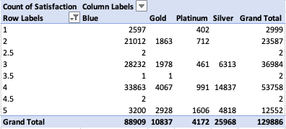
Satisfaction Vs Airline Status
Silver is the most satisfaction-guaranteed airline status, followed by gold
Platinum status has the least number of customers, whereas blue status have more than half the customers

Slide 13
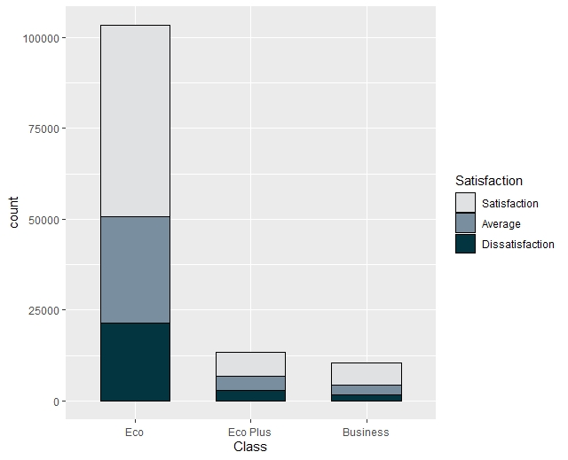
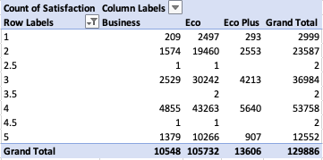
Satisfaction Vs Class
Economy class has the highest proportion of dissatisfied and moderately satisfied customers, followed by economy plus.

Slide 14
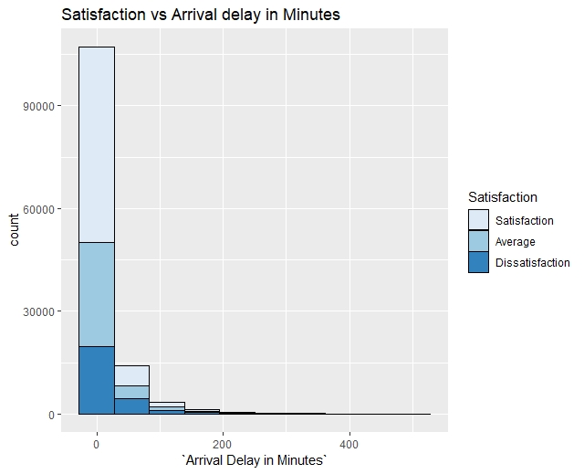
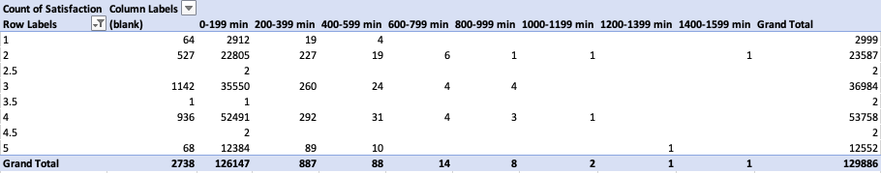
Satisfaction Vs Arrival delay in minutes
Higher arrival delay leads to a lesser customer satisfaction

Slide 15
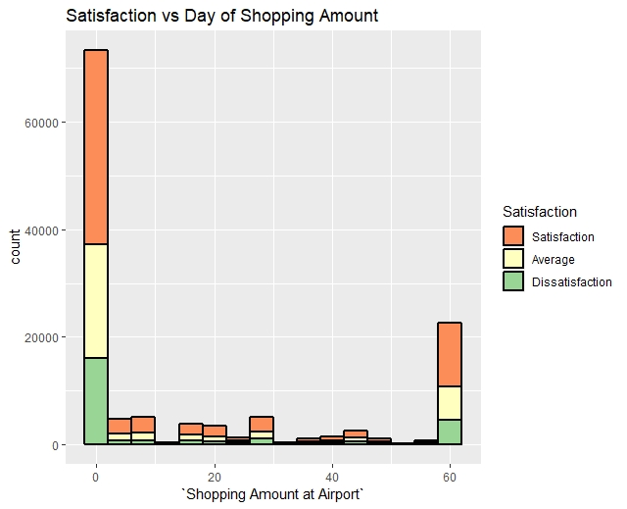
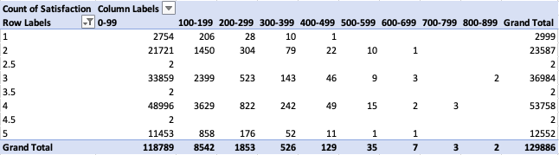
Satisfaction Vs shopping amount
With increase in shopping amount, there is an increase in the proportion of satisfied customers
Most of the customers do not shop at airports

Slide 16
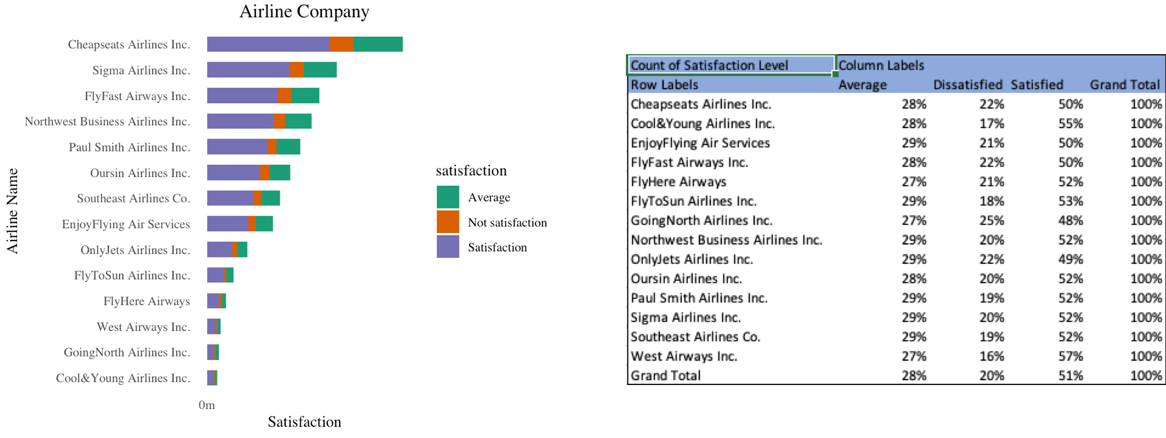
Satisfaction Vs Airline company
West Airways Inc. and Cool&Young Airlines Inc. have lesser dissatisfaction than Southeast Airlines Co.
Overall, Southeast Airlines performs better than most of its competitors

Slide 17
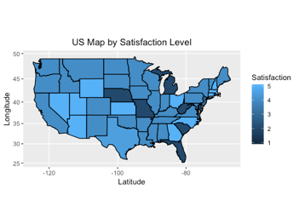
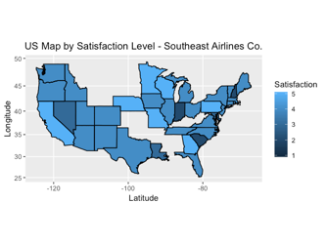
Geographical service benchmarking
Comparing satisfaction levels with all flights considered and Southeast Airlines Co., it can be identified that service in the following states can be improved by the client:
Nevada, Utah, Arizona, New Hampshire, Virginia and Ohio

Slide 18
Data analysis
Notes:
Project goals
Descriptive statistics
Linear Model
A rules

Slide 19
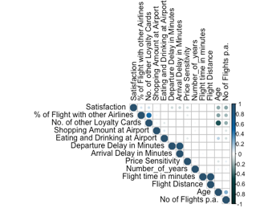
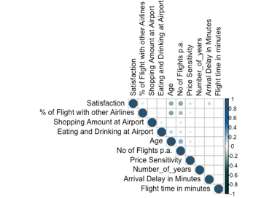
Transformation for Linear Regression
Initial Correlation Matrix
Final Correlation Matrix
The correlation matrix was plotted, and multicollinearity was removed
The outliers were removed from the data
All the numerical variables were Z-transformed to remove scaling issues

Slide 20
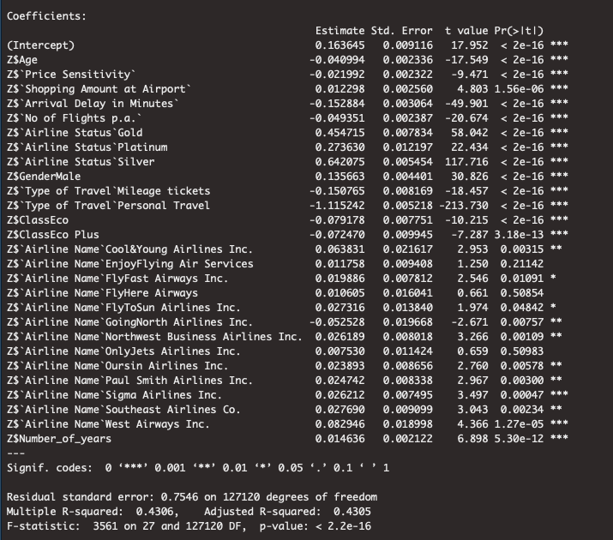
Multiple Linear Regression Analysis
Key Interpretations
Variable | Change in Variable | Effect on Customer Satisfaction Index
Age | Increase | Decrease
Price Sensitivity | Increase | Decrease
Shopping amount at Airport | Increase | Increase
Number of flights per annum | Increase | Decrease
Airline Status | Change in status | Silver > Gold > Platinum > Blue
Gender | Change in gender | Male > Female
Type of travel | Change in type of travel | Business > Mileage > Personal
Class | Change in class | Business > Eco Plus > Eco
Number of years | Increase | Increase

Slide 21
Multiple Linear Regression Analysis
Recommendations
● Satisfaction level for the client is high among their passengers, so they should now focus on the segment of passengers who are price sensitive, and implement flexibility of pricing
● There must be more capital invested into improving the service in economy class and blue status carriers, which is targeted towards the personal travel segment
● There must be more marketing done for the silver and gold status carriers, as well as the business class seats; the target segment for this marketing must be mileage travel and business travel passengers

Slide 22
Association Rules
Category | Common traits | Rating
High | Silver status business travel Male middle aged no delay low price sensitivity | Greater than 4
Average | Personal travel Female economy class no delay high number of flights per annum | Between 3 and 4
Low | Blue status personal travel delayed | Below 3

Slide 23
Support vector machine
To validate the precision of the SVM model, we calculated the error rate of this model. The error rate is 22.56%
The SVM model accurately predicts whether a customer is satisfied or not 78% of the time
Classification | Satisfaction(predict) | Dissatisfaction(predict)
Dissatisfaction | 1547 (Wrongly classified) | 2767
Satisfaction | 3859 | 384 (Wrongly classified)

Slide 24
Recommendations
Notes:
Project goals
Descriptive statistics
Linear Model
A rules

Slide 25
Recommandations - Descriptive statistics
There is scope for improvement for client in terms of overall service in the following states: Nevada, Utah, Arizona, New Hampshire, Virginia and Ohio
There can be more capital expenditure directed to improve operations in these areas

Slide 26
Recommandations - Linear Model
Satisfaction level for the client is high among their passengers, so they should now focus on the segment of passengers who are price sensitive, and implement flexibility of pricing
There must be more capital invested into improving the service in economy class and blue status carriers, which is targeted towards the personal travel segment
There must be more marketing done for the silver and gold status carriers, as well as the business class seats; the target segment for this marketing must be mileage travel and business travel passengers

Slide 27
Recommandations - Association Rules
High satisfaction:
The client could focus on marketing the silver status package more, to improve sales. Even if they evolve the pricing strategy into a dynamic pricing, the cluster of passengers who are on business travel, or are not price sensitive, would be attracted due to the services that are available to them
The airline routes which have lesser traffic should nest a silver or gold status airline, as the target customer demographics would comprise of older people, who highly value arrival-on-time and good hospitality
The client should focus on creating partnership with any Multinational Companies, and developing bundle-packages for them in the business class segment. The target segment comprises of many middle-aged business class travelers, who would be highly satisfied

Slide 28
Recommandations - Association Rules
Moderate satisfaction:
Low-priced business class plans must be created for this segment. This would result in a higher satisfaction level
The client must focus on improving service in the blue status airlines, which should improve the satisfaction level in the passengers in this segment
Females traveling through economy give a strong priority on the overall value associated with the airline’s service. The client should consider creating value-oriented bundle plans, or lowering the ticket prices, specifically for women

Slide 29
Recommandations - Association Rules
Low satisfaction:
The client must focus upon improving services for the blue airline status, as well as the economy class seats
Lower price setting for business class seats in blue airline status might trigger a higher satisfaction level

Slide 30
thanks!
Any questions?

